Slide 1




SQL PROJECT ON NETFLIX DATA
This project involves a comprehensive analysis of Netflix's movies and TV shows data using SQL. The goal is to extract valuable insights and answer various business questions based on the dataset
02

Slide 2
OBJECTIVE
Analyze the distribution of content types (movies vs TV shows).
Identify the most common ratings for movies and TV shows.
List and analyze content based on release years, countries, and durations.
Explore and categorize content based on specific criteria and keywords.

Slide 3
-- 15 Business Problems & Solutions
1. Count the number of Movies vs TV Shows
2. Find the most common rating for movies and TV shows
3. List all movies released in a specific year (e.g., 2020)
4. Find the top 5 countries with the most content on Netflix
5. Identify the longest movie
6. Find content added in the last 5 years
7. Find all the movies/TV shows by director 'Rajiv Chilaka'!
8. List all TV shows with more than 5 seasons
9. Count the number of content items in each genre
10.Find each year and the average numbers of content release in India on netflix.
return top 5 year with highest avg content release!
11. List all movies that are documentaries
12. Find all content without a director
13. Find how many movies actor 'Salman Khan' appeared in last 10 years!
14. Find the top 10 actors who have appeared in the highest number of movies produced in India.
15.
Categorize the content based on the presence of the keywords 'kill' and 'violence' in
the description field. Label content containing these keywords as 'Bad' and all other
content as 'Good'. Count how many items fall into each category.

Slide 4
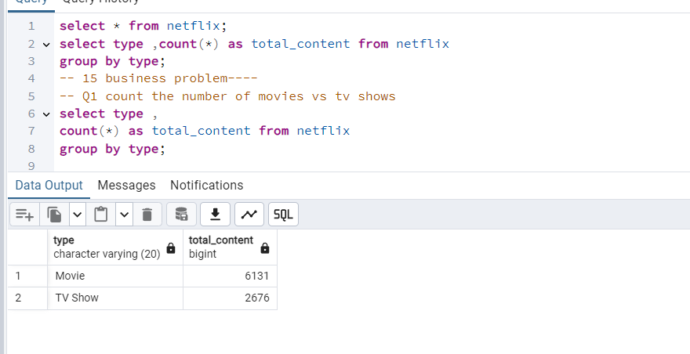
1. Count the number of Movies vs TV Shows

Slide 5
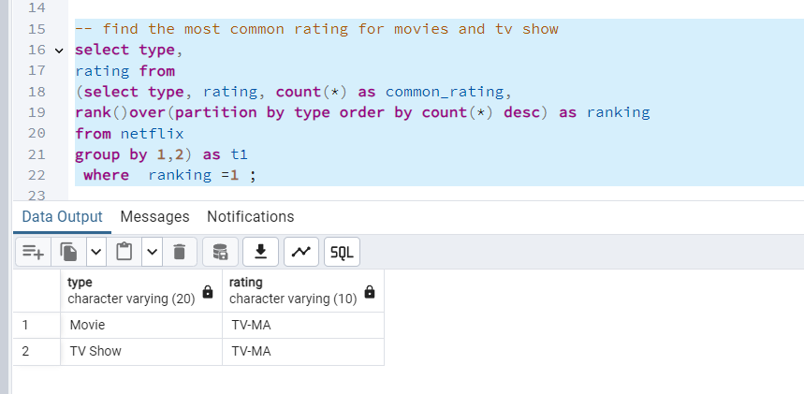
2. Find the most common rating for movies and TV shows

Slide 6
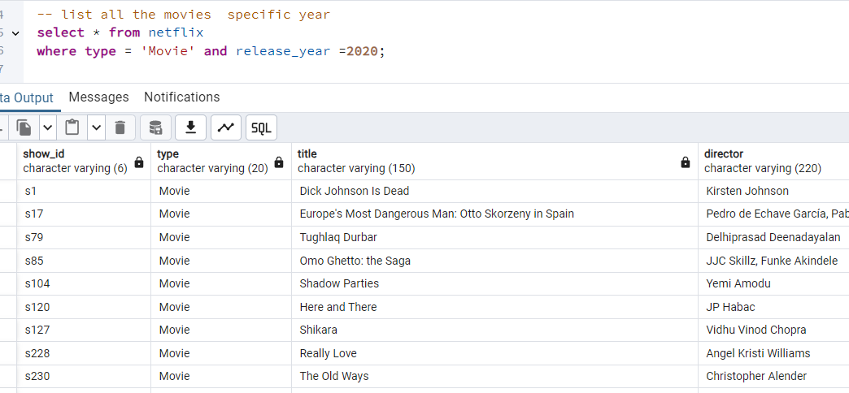
3. List all movies released in a specific year (e.g., 2020)

Slide 7
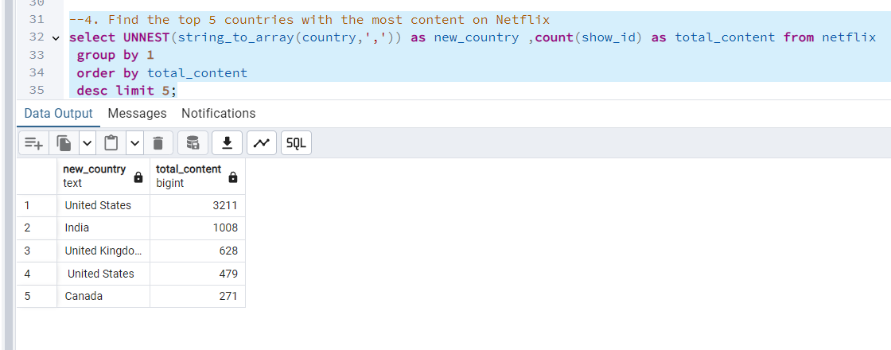
4. Find the top 5 countries with the most content on Netflix
Your paragraph text

Slide 8
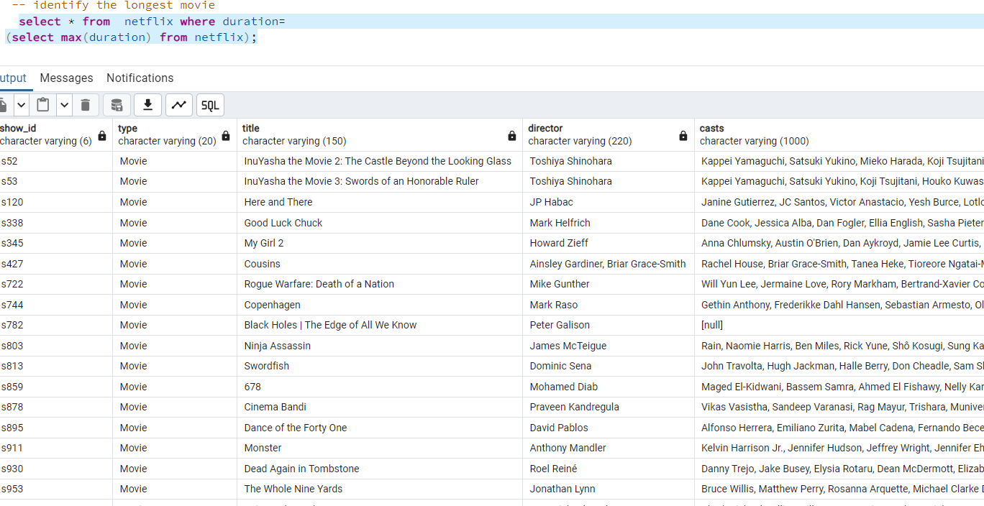
5. Identify the longest movie

Slide 9
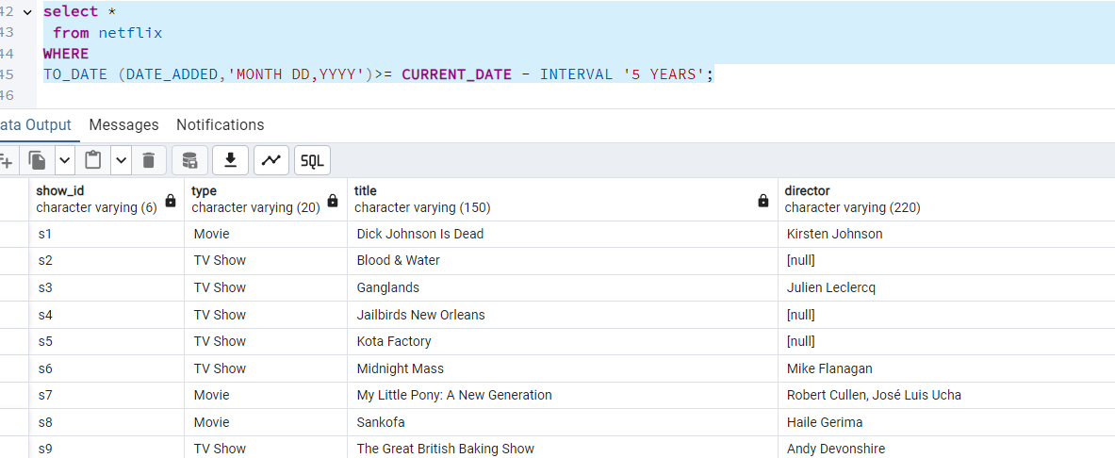
6. Find content added in the last 5 years

Slide 10
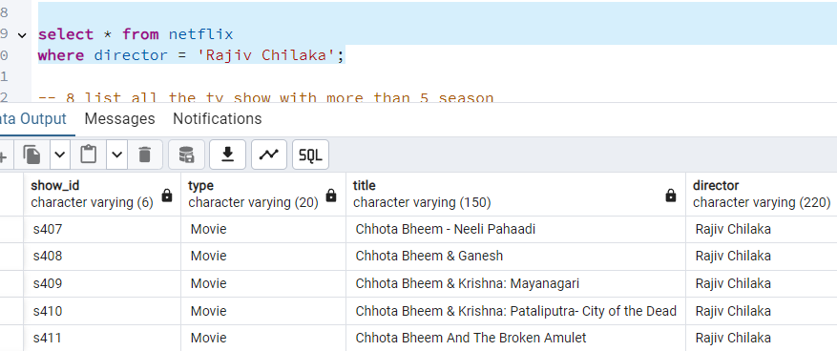
7. Find all the movies/TV shows by director 'Rajiv Chilaka'!

Slide 11
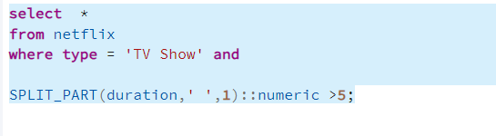
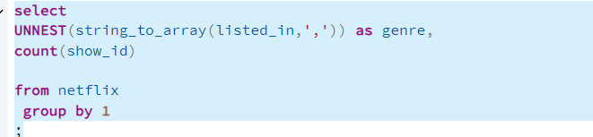
8. List all TV shows with more than 5 seasons
9. Count the number of content items in each genre

Slide 12
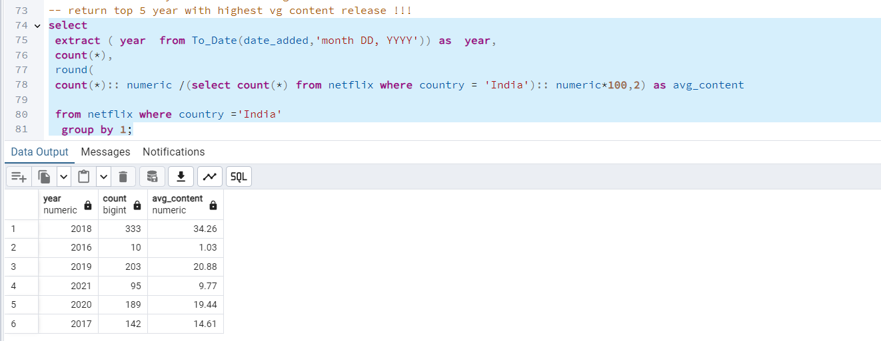
10.Find each year and the average numbers of content release in India on netflix.

Slide 13
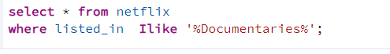
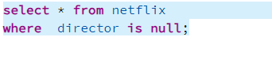
11. List all movies that are documentaries
12. Find all content without a director

Slide 14
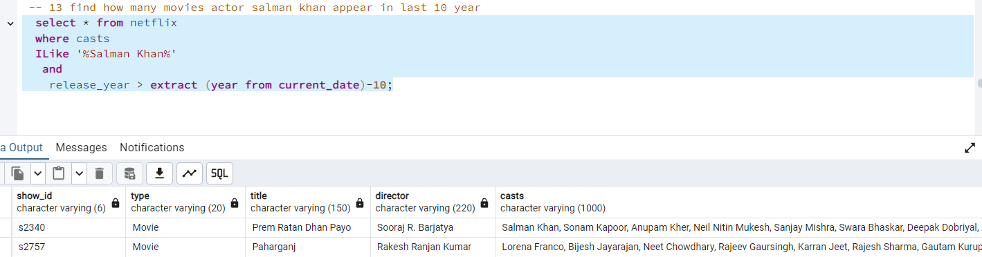
13. Find how many movies actor 'Salman Khan' appeared in last 10 years!

Slide 15
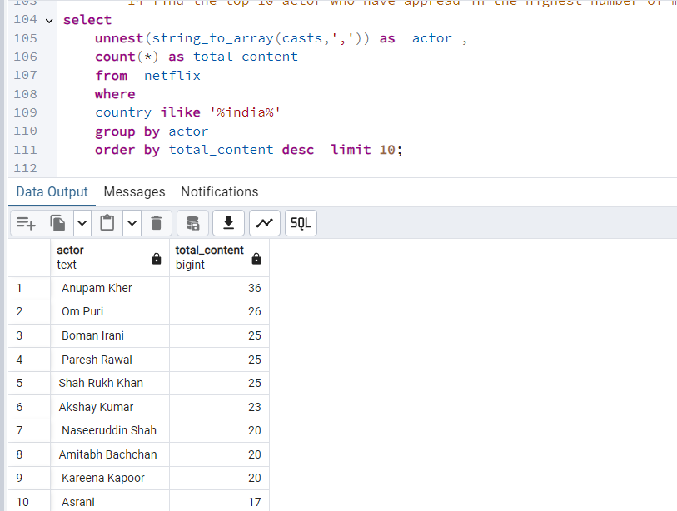
14. Find the top 10 actors who have appeared in the highest number of movies produced in India.

Slide 16
